Slide 1
Intercept 5 Community Supervision
Criminal Justice – Behavioral Health: Partnerships Creating Integrated Healthcare
January 29-31, 2017
Magdalena Morales-Aina, LPC-S, LPCC
Director
El Paso County Community Supervision
and Corrections Department

Slide 2
Definitions
Community Supervision is:
The effort to monitor the offender’s behavior and program compliance outside of the court room.
Accomplished through a system of support, monitoring and advocacy to assist the client through change.

Slide 3
Community Supervision
Community Supervision Officers
Probation Officers
Parole Officers
Pre-Trial Supervision Officers

Slide 4
Brief History
Historically, courts and criminal justice practitioners used a “one size fits all” approach to community Supervision.

Slide 5
The Model
The “one size fits all” model assumed that criminal justice programs and services should cater to groups of offenders as offenders rather than recognizing their varying cultures and backgrounds.

Slide 6
Culturally Competent Systems
Today, the more progressive courts, treatment courts, and criminal justice institutions recognize the role that cultural competence plays in successful community supervision programs and services.

Slide 7
Cultural Competence
For this presentation, cultural competence is defined as a set of behaviors, attitudes, policies, and practices that enable a Court, Specialty Court, or criminal justice organization to provide culturally appropriate service(s) to a culturally complex clientele.

Slide 8
Community Supervision
Best Practices

Slide 9
Community Supervision Practices
The goal community supervision is reduced recidivism through systemic integration of Evidence Based Practices (EBP) in adult community corrections. The integrated model of implementation focuses equally on EBP, organizational development, and collaboration.

Slide 10
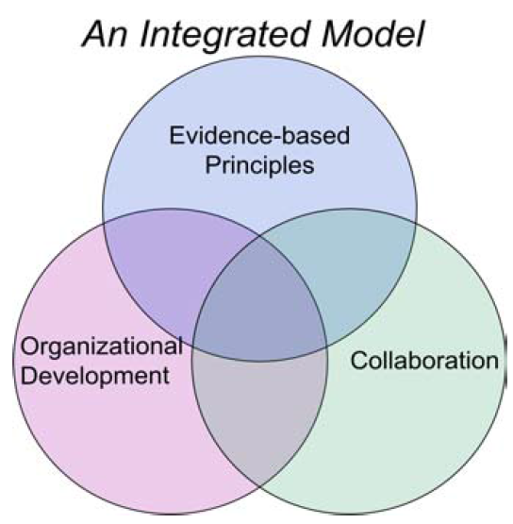
Integrated Model
Integrated Model is to reduced recidivism through implementation of systemic integrated model that focuses equally on
Evidence Based Principles (EBP)
Organizational Development
Cross-system Collaboration
http://static.nicic.gov/Library/024107.pdf

Slide 11
Eight Evidence-Based Principles for Effective Interventions
1. Assess Actuarial Risk/Needs (Risk Assessment & Clinical Assessments)
2. Enhance Intrinsic Motivation (Motivational Interviewing (MI) Cognitive Behavior Treatment Models)
3. Target Interventions
a. Risk Principle: Prioritize supervision and treatment resources for higher risk offenders.
b. Need Principle: Target interventions to criminogenic needs.
c. Responsivity Principle: Be responsive to temperament, learning style, motivation, culture, and gender when assigning programs.
4. Skill Train with Directed Practice (Use Cognitive Behavioral treatment methods).
5. Increase Positive Reinforcement
6. Engage Ongoing Support in Natural Communities (Reintegration - pro-social supports for offenders in their communities.)
7. Measure Relevant Processes/Practices (Outcome Measures).
8. Provide Measurement Feedback (Quality Assurance / Performance Audits)
http://static.nicic.gov/Library/024107.pdf

Slide 12
Essential Ingredients for Effective Interventions
Incorporate Policy and Practice: consider evidence-based changes to external statutes and regulations as well as internal policy and procedure.
Develop an Organizational Case Plan: assess organizational needs, create a strategic plan, and implement the plan. Align all business practices with the evidence, not just supervision strategies.
Build on Risk, Need, Treatment, and Fidelity: The pillars of evidence-based practice are effective assessment, case plans focused on criminogenic needs, effective treatment, and a quality assurance process that ensures all facets are being implemented according to research.
Prioritize the Workforce: Focus on employee development, including awareness of research, skill development, and management of behavioral and organizational change processes, within the context of a complete training program and supportive human resources practice. Develop leaders at all levels of the organization.
Measure for Accountability and Improvement: Assess baseline and subsequent progress using quantifiable data. Routinely measure employee practices (attitudes, knowledge, and skills) that are related to outcomes.
Use Data: Provide employees timely, relevant, and accurate feedback regarding performance related to outcomes. Utilize extensive data-driven advocacy and brokerage to enable appropriate community justice/correctional services.
Engage and Communicate: Internal and external stakeholders require constant communication on the process of EBP implementation, their role in it, the vision for the future, and the outcomes that are realized. You can never have too much effective communication!

Slide 13
Establish Terms and Conditions
Terms and Conditions
Risk Need Responsivity
Supervision Plan
Treatment Plan
Continuity of Care
Monitor Compliance

Slide 14
Community Supervision
Court
Treatment

Slide 15
EFFECTIVE SUPERVISION
Evidence Based Practices (EBP)
Risk-Need-Responsivity
Continuity of Care
Trauma Informed Care
Cultural Competence

Slide 16
Questions?
Thank You!

